Slide 1
University Database Model
Project Team 8
Tushar Pagadala Ashok
Rohan Sanjay Nayak
Akhil Kaundinya Metlakunta
Rucha Sachin Chauthai

Slide 2









Objectives
Campuses
What if?
A
B
Student wants to register the courses offered by other campuses(Online/In-Person)
C
D

Slide 3
Objectives
Campuses
Resolution
A
B
All University Campuses should have a centralized Database
Makes Course Registration Easier - Students can take up courses offered by any Campus
C
D

Slide 4



Objectives
Campuses
Student Academic
Performance
A
B
Grades
Determining the low-scorers from each course and by Professor
C
D

Slide 5

Objectives
Campuses
What If?
A
B
Is a professor overloaded with a lot of sections?
Provide a report of all number of students by sections to optimize the allocation of students.
C
D

Slide 6

Objectives
Campuses
Popularity of a Course
A
B
How Registrations for a Course across all semesters?
C
D

Slide 7

Objectives
Campuses
Choosing Academic Advisor
A
B
Flexibility to choose any advisor for any department.
Also, looking into students performance by Advisor
C
D
Notes:
All University Campuses should have a centralized Database
Students Academic Performance
Determine the low scorers by Course
Is a professor overloaded with a lot of sections?
Provide a report of all number of students by sections to optimize the allocation of students.
Making the course registration easier –
Students can take up courses offered by any Campus
Popularity of Courses or Class
Assigning Academic Advisor
Identify the low-scorers.
Flexibility in choosing an advisor from any department

Slide 8
ER Diagram & Design Considerations

Slide 9
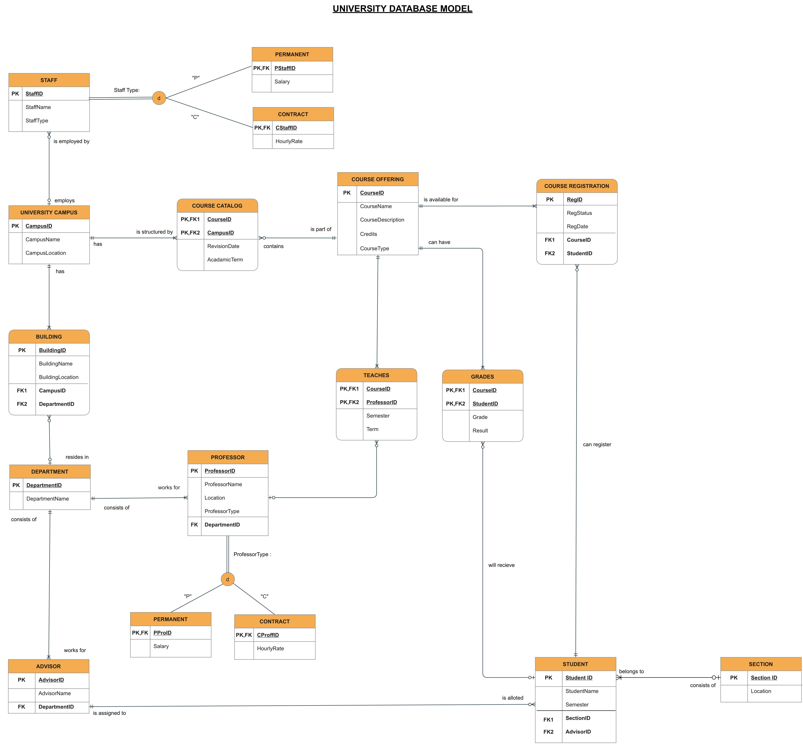
Design Considerations
Using Course Registration as associative entity – popularity of courses, timeline of registrations, Students who are ‘waitlisted’

Slide 10
Design Considerations
Using Grades as associative entity – Low scorers, Courses which performed better based on avg CGPA

Slide 11
Design Considerations
Using Teaches as associative entity – Professors teaching the number of courses

Slide 12
Design Considerations
Addition of SubTypes for both Professors and Staff

Slide 13
Database Implementation

Slide 14
Database Objects
Created a total of 17 tables. (Using CREATE Statements)
Table level CHECK Constraints on UniversityCampus, CourseOffering, CourseCatalog, Professor and Staff
Computed Columns based on a function used to Change the CGPA to Grade/
VIEWS
Report on Student Academic Performance
Getting the professor information, Classes he teaches, Department he belongs to
Number of Students registered for a Course – Popularity of Courses.
Stored Procedures
Updating CourseRegistration Status(to ‘Dropped’) by the student or faculty
To get professor and course details of students by particular grade
Total Number of Courses Offered by Campus for a particular Term
Finding the number of Students assigned by Advisor
Non-Clustered Indexes on Student(StudentName) and Grades(CGPA)
Column Data Encryption on the Student Table – Student’s User Name and Password
TRIGGERS – on grade changes(INSERT/UPDATE) and CourseRegistration(INSERT/UPDATE)

Slide 15
PowerBI Dashboard
https://app.powerbi.com/groups/me/apps/fe266cc8-8359-4bae-8098-91355728f918?ctid=a8eec281-aaa3-4dae-ac9b-9a398b9215e7

Slide 16
Thank you
Link to all the materials:
(DDL & DML Scripts, PBI report, Design Document)
https://onedrive.live.com/?authkey=%21AKWYR9BMRZxDpO8&id=EA5747F9FFC1C6AB%215071&cid=EA5747F9FFC1C6AB
Link to PBI Dashboard:
Power BI
Notes:
Add links

Slide 17
Contributions
Design Document(Objectives, Key Design Ideas), ERD Revisions, Creating Tables, Views, Triggers, Table-Level Check Constraints, Computed Column, PowerBI Report/Dashboard, Insertion Scripts – Tushar
Design Document(Entities), ERD Revisions, Creating Tables , Data Population, Column Data Encryption – Rohan
Creating Tables, Design Document(Business Rules), ERD Drawing, Views – Akhil
Creating Tables, Stored Procedures, Non-Clustered Indexes - Rucha

